Slide 1
IMAGE CONVOLUTION
TEAM MEMBERS
ADARSH LIJU ABRAHAM (PES2UG20CS017)
ANANYA ADIGA (PES2UG20CS043)
AMEY MITTAL (PES2UG20CS037)
ABHISHEK S KUTRE (PES2UG20CS012)

Slide 2
Abstract
Image convolution is an important image processing technique where two signals(images) are combined to form a third signal mathematically. Here we deal with images using a linear Invariant system (LTI system) where an image is the input and the output is always linear.
In simple terms, an image convolved with mask ,where mask is a signal represented by a two dimensional matrix. You start with a kernel ,which is a small matrix of weights. This kernel slides over the 2D input data, performing an elementwise multiplication with the part of the input it is currently on, and then summing up the results into a single output pixel.
We use image convolution as it overcomes the other two methods of manipulating images by sharpening, blurring, edge detection and noise reduction.

Slide 3



Libraries Used

Slide 4
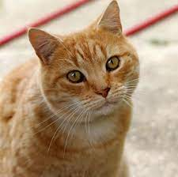
Original Image
cat.jpg

Slide 5
Resizing and Image
Introduction
Resizing an image means changing the dimensions of it, be it width alone, height alone or changing both of them. Also, the aspect ratio of the original image could be preserved in the resized image. To resize an image, OpenCV provides cv2.resize() function.
Syntax
cv2.resize(src, dsize[, dst[, fx[, fy[, interpolation]]]])

Slide 6
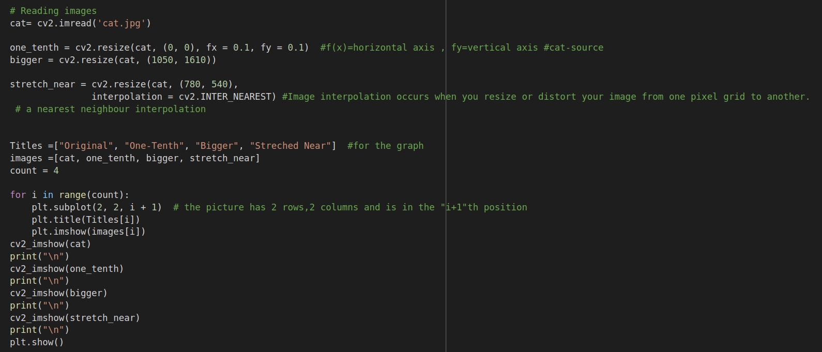
Resizing and Image
Code

Slide 7
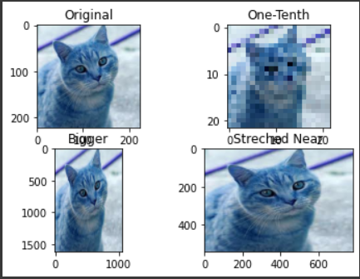
Resizing and Image
Output

Slide 8

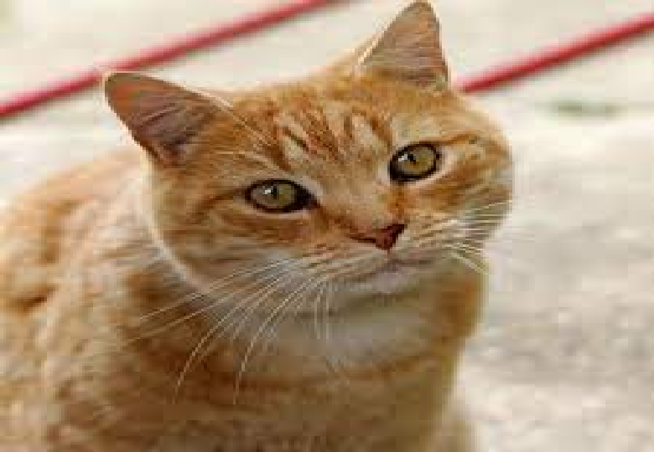
Resizing and Image
Output

Slide 9
Rotating an Image
Steps to Rotate an Image
First, you need to get the center of rotation. This typically is the center of the image you are trying to rotate.
Next, create the 2D-rotation matrix. OpenCV provides the getRotationMatrix2D() function that we discussed above.
Finally, apply the affine transformation to the image, using the rotation matrix you created in the previous step. The warpAffine() function in OpenCV does the job.
The warpAffine() function applies an affine transformation to the image. After applying affine transformation, all the parallel lines in the original image will remain parallel in the output image as well

Slide 10
Rotating an Image
getRotationMatrix2D()
Syntax
cv2.getRotationMatrix2D(center, angle, scale)
The getRotationMatrix2D() function takes the following arguments:
center: the center of rotation for the input image
angle: the angle of rotation in degrees
scale: an isotropic scale factor which scales the image up or down according to the value provided

Slide 11
Rotating an Image
warpAffine()
warpAffine(src, M, dsize[, dst[, flags[, borderMode[, borderValue]]]])
The warpAffline() function takes the following arguments:
src: the source mage
M: the transformation matrix
dsize: size of the output image
dst: the output image
flags: combination of interpolation methods such as INTER_LINEAR or INTER_NEAREST
borderMode: the pixel extrapolation method
borderValue: the value to be used in case of a constant border, has a default value of 0

Slide 12
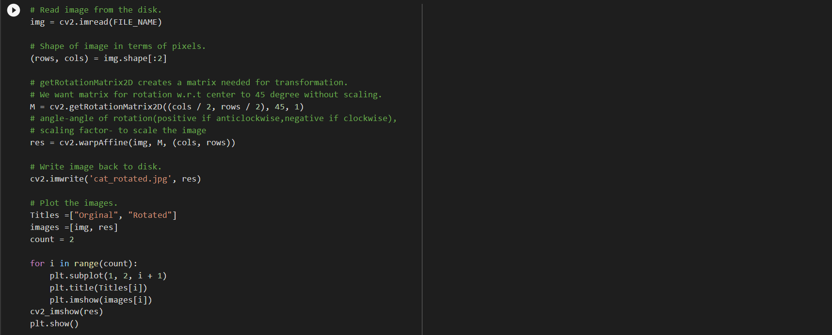
Rotating an Image
Code

Slide 13
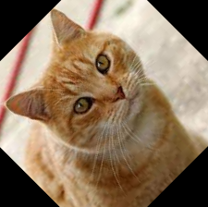
Rotating an Image
Output

Slide 14
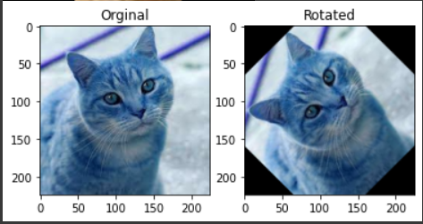
Rotating an Image
Output

Slide 15
Image Translation
Translation refers to the rectilinear shift of an object i.e. an image from one location to another. If we know the amount of shift in horizontal and the vertical direction, say (tx, ty) then we can make a transformation matrix
Where tx denotes the shift along the x-axis and ty denotes shift along the y-axis i.e. the number of pixels by which we need to shift about in that direction.
Numpy is used for creating important matrices like translation matrix.
Advantages
Hiding a part of the image
Cropping an image
Shifting an image
Animating an image using image translations in loop.

Slide 16
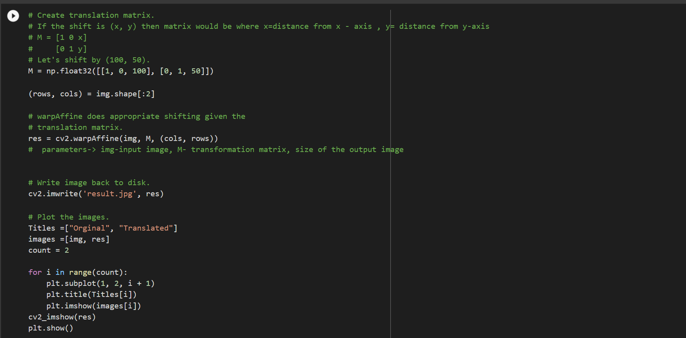
Image Translation
Code

Slide 17
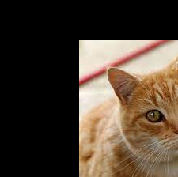
Image Translation
Output

Slide 18
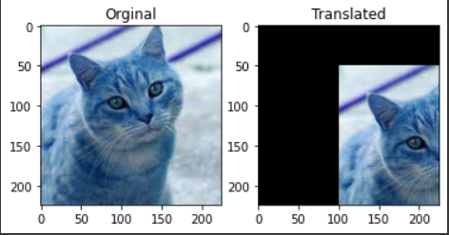
Image Translation
Output

Slide 19
Canny Edge Detection
The process of Canny edge detection algorithm can be broken down to five different steps:
Apply Gaussian filter to smooth the image in order to remove the noise
Find the intensity gradients of the image
Apply gradient magnitude thresholding or lower bound cut-off suppression to get rid of spurious response to edge detection
Apply double threshold to determine potential edges
Track edge by hysteresis: Finalize the detection of edges by suppressing all the other edges that are weak and not connected to strong edges.

Slide 20
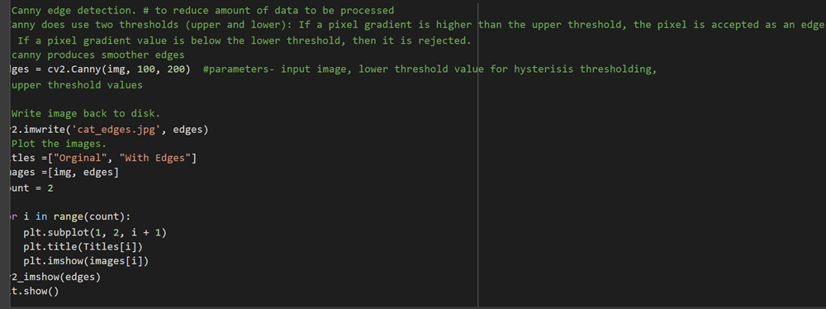
Canny Edge Detection
Code

Slide 21
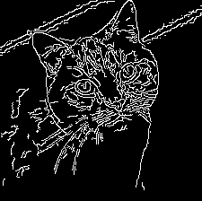
Canny Edge Detection
Output

Slide 22
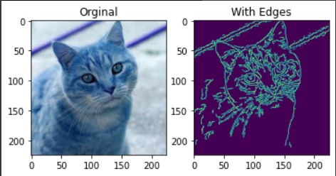
Canny Edge Detection
Output

Slide 23
Gaussian Blur
Gaussian Blur aims to reduce the level of noise in the image, which improves the result of the following edge-detection algorithm and lower the intensity as well as smoothen the image.
SYNTAX: GaussianBlur(src, dst, ksize, sigmaX)
This method accepts the following parameters −
src − A Mat object representing the source (input image) for this operation.
dst − A Mat object representing the destination (output image) for this operation.
ksize − A Size object representing the size of the kernel.
sigmaX − A variable of the type double representing the Gaussian kernel standard deviation in X direction.

Slide 24
Gaussian Blur
CODE
# Gaussian Blur - to remove noise, smoothning the image, lower intensity
Gaussian = cv2.GaussianBlur(img, (7, 7), 0) #parameters- source,size of kernel,standard deviation
cv2_imshow(Gaussian)

Slide 25
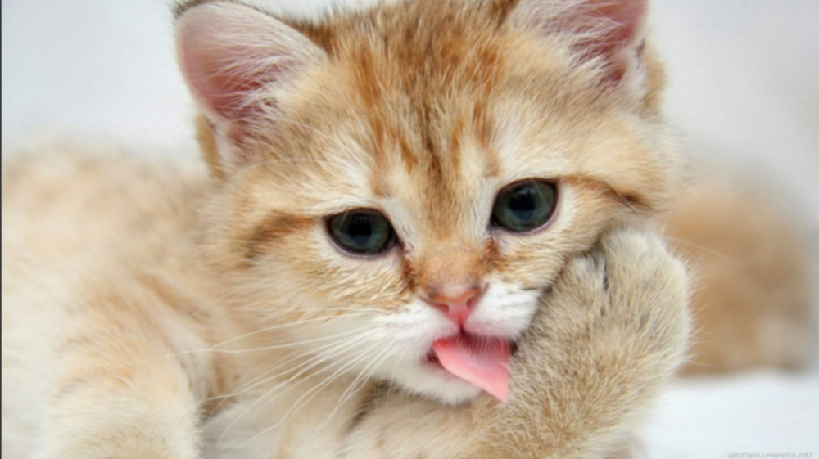
GAUSSIAN BLUR
OUTPUT

Slide 26
MEDIAN BLUR
The Median blur operation is similar to the other averaging methods. Here, the central element of the image is replaced by the median of all the pixels in the kernel area. This operation processes the edges while removing the noise.
SYNTAX:medianBlur(src, dst, ksize)
This method accepts the following parameters −
src − A Mat object representing the source (input image) for this operation.
dst − A Mat object representing the destination (output image) for this operation.
ksize − A Size object representing the size of the kernel.

Slide 27
MEDIAN BLUR
CODE
# Median Blur-central element is replaced by median of all pixels in the kernel area
median = cv2.medianBlur(img, 5) #source and kernel size
cv2_imshow(median)

Slide 28
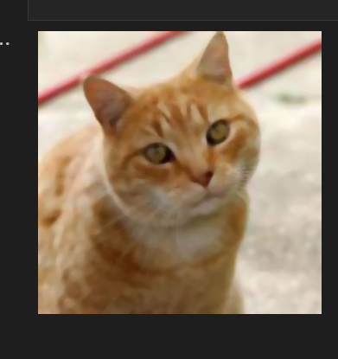
MEDIAN BLUR
OUTPUT

Slide 29
BILATERAL BLUR
Bilateral Filtering is an advanced version of Gaussian blurring. Blurring produces not only dissolving noises but also smoothing edges. And bilateral filter can keep edges sharp while removing noises.
SYNTAX: bilateralFilter(src, dst, d, sigmaColor, sigmaSpace, borderType)
This method accepts the following parameters −
src − A Mat object representing the source (input image) for this operation.
dst − A Mat object representing the destination (output image) for this operation.
d − A variable of the type integer representing the diameter of the pixel neighborhood.
sigmaColor − A variable of the type integer representing the filter sigma in the color space.
sigmaSpace − A variable of the type integer representing the filter sigma in the coordinate space.
borderType − An integer object representing the type of the border used.

Slide 30
BILATERAL BLUR
# Bilateral Blur
bilateral = cv2.bilateralFilter(img, 9, 75, 75) #src,diameter of pixel,filter sigma in color space, filter sigma in coordinate space
cv2_imshow(bilateral)

Slide 31
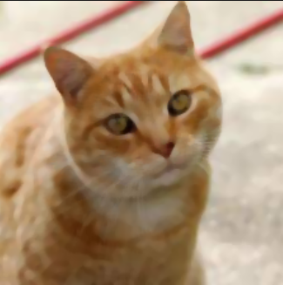
BILATERAL BLUR
OUTPUT

Slide 32
COMPARING Gaussian, Median and Bilateral blur
All the three blurs are imported from the class imgproc. The main difference between Gaussian and bilateral blur is that bilateral blur can keep the edges sharp while removing noises and uses standard deviation to modify the intensity.
Difference between Median and Gaussian is that, median uses the central element of the image is replaced by the median of all the pixels in the kernel area.

Slide 33
COMPARING Gaussian, Median and Bilateral blur
Titles =["Gaussian Blur", "Median Blur","Bilateral Blur"]
images =[Gaussian,median,bilateral]
count = 3
for i in range(count):
plt.subplot(2, 2, i + 1)
plt.title(Titles[i])
plt.imshow(images[i])
plt.show()

Slide 34
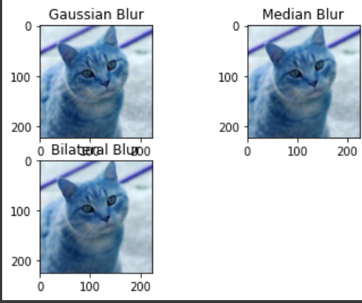
COMPARING Gaussian, Median and Bilateral blur

Slide 35
Advantages

Slide 36
70%
Of the Servers in the world use Image Convolution to save,resize and format data
Even WhatsApp

Slide 37
Thank You

